Slide 1
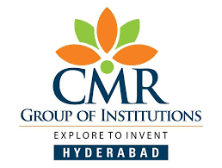
CMR COLLEGE OF ENGINEERING & TECHNOLOGY
Kandlakoya, Medchal, Hyderabad - 501401
Department of Computer Science and Engineering
Bio-Medical Image Segmentation And Detection For Brain Tumour And Skin Lesions Diseases Through U-NET
Name of the student
G. Harshitha (20H51A0511)
G. Suresh Kumar (20H51A0594)
P. Deepika (20H51A05P7)
Under esteemed guidance of
Guide Name
Ms. Y. Sailaja

Slide 2
Outline
Abstract
Introduction
Literature survey
Existing system
- Problems in existing system
Research Objective of Presentation
Problem Definition
Research work
- Proposed system architecture
- Methods
- Comparison of Proposed system with an existing system
Performance Measure
Results
Conclusion
Future Work
References
Notes:
2

Slide 3
Abstract
Notes:
3

Slide 4
ABSTRACT
The research concentrates on enhancing the precise identification and localization of diseases within medical images, a pivotal component of medical imaging analysis crucial for diagnoses and treatment planning. Employing the U-Net architecture, renowned for its effectiveness in biomedical image segmentation, the study targets the detection of brain tumors and skin lesions in MRI or CT scans. Notably, the proposed methodology not only detects diseases but also offers detailed insights into their dimensions and spatial distribution. Extensive experimental validation showcases the method's superiority over existing approaches, underscoring its potential for holistic learning in medical image analysis.

Slide 5
INTRODUCTION
Notes:
5

Slide 6
Introduction
As the biomedical field advances, various sectors increasingly utilize biomedical signals captured through imaging for multiple purposes. This encompasses the generation of a substantial volume of images. These images play a pivotal role in supporting healthcare professionals by swiftly and accurately localizing anatomical lesions and gauging disease progression. However, the sheer volume of image data poses a challenge, especially given the limited number of experienced physicians. Consequently, relying solely on manual processing would be time-consuming, labour-intensive, and highly inefficient. The Bio-Medical Image Segmentation System employing U-Net represents a sophisticated and effective approach in the field of medical image analysis. U-Net is a convolutional neural network architecture specifically designed for semantic segmentation tasks, making it well-suited for the intricate details and structures present in biomedical images.
Notes:
6

Slide 7
Literature Survey
Notes:
7

Slide 8
Existing system
Brain Tumour:
The current approach to segmenting brain tumours involves the utilization pertaining to deep neural networks techniques coupled with an attention mechanism applied to multi-modal MRI images. By incorporating various MRI modalities such as FLAIR, T1C, T1, and T2, the approach aims to gather comprehensive insights into both the anatomy and pathology of the brain. The attention mechanism enables the model to focus on pertinent regions within the images, thereby enhancing segmentation precision. At the heart of this approach lies a convolutional neural network (CNN) architecture specifically tailored for efficiently processing multi-modal MRI data. Moreover, advanced techniques for feature fusion are implemented to amalgamate information from diverse modalities, thereby enhancing the model's capacity to capture a wide range of tumour characteristics. Overall, the current system approach strives to achieve precise and resilient segmentation of brain tumours, which is pivotal for clinical diagnosis and treatment planning.
Notes:
8

Slide 9
Drawbacks:
While this approach boasts several strengths, it faces a potential drawback concerning its limited generalization, especially when encountering unfamiliar datasets or diverse patient demographics. If the model undergoes training on a dataset with limited variability, it may encounter challenges in accurately segmenting tumours across different imaging conditions or varied clinical contexts. Overcoming this limitation is essential to uphold the approach's efficacy and relevance in real-world clinical applications.

Slide 10
Skin Lesions:
The current system emphasizes skin lesion segmentation through the utilization of deep learning techniques, integrating an auxiliary task to improve performance. This likely involves the development of a customized deep learning architecture, potentially a convolutional neural network (CNN), specifically tailored for the task of segmenting skin lesions. The inclusion of an auxiliary task alongside the primary segmentation objective aims to enhance the model's accuracy by leveraging additional information or regularization techniques. Model training involves annotated datasets of skin lesion images paired with corresponding segmentation masks, with evaluation conducted using standard metrics such as the Dice similarity coefficient or Intersection over Union (IOU). Overall, this approach strives to advance skin lesion segmentation accuracy through deep learning methodologies while addressing challenges such as limited generalization and data availability.

Slide 11
Drawbacks:
Obtaining diverse and extensive datasets with annotated skin lesion images for training presents a notable obstacle. The limited availability of high-quality annotated data might impede the model's ability to adjust to different types of skin lesions and imaging conditions.

Slide 12
Research Objective
Notes:
12

Slide 13
Research objective
The scope and objective of the Bio-Medical Image Segmentation System utilizing U-Net are centred around advancing the accuracy and efficiency of medical image analysis. The primary aim is to enhance the precision of identifying and delineating specific structures within biomedical images, such as tumours or lesions, through a sophisticated neural network architecture. This system addresses the growing demand for automated and reliable segmentation techniques, offering a valuable tool for healthcare professionals in tasks like disease diagnosis, treatment planning, and monitoring.
The scope extends to various medical imaging modalities, including MRI and CT scans, emphasizing the versatility of U-Net in handling complex and diverse data. By providing detailed and accurate segmentation results, the objective is to streamline clinical workflows, improve diagnostic outcomes, and ultimately contribute to more effective and personalized patient care in the field of biomedical imaging.

Slide 14
Problem Definition
Notes:
14

Slide 15
Problem Definition
Medical imaging technologies have significantly transformed the landscape of disease diagnosis and injury assessment in healthcare. Among the widely used modalities such as radiography, magnetic resonance imaging (MRI), ultrasound, and computed tomography (CT), interpreting the resulting images requires substantial analysis. Image segmentation emerges as a crucial technique in this regard. Through image segmentation, healthcare professionals can pinpoint regions of interest within medical images, particularly those affected by diseases. This process enables the extraction of pertinent information, including the presence of disease within the image and its precise location. Accurate segmentation plays a pivotal role in various aspects of healthcare, ranging from diagnosis and treatment planning to surgical interventions and treatment monitoring.

Slide 16
Research Work
Notes:
16

Slide 17
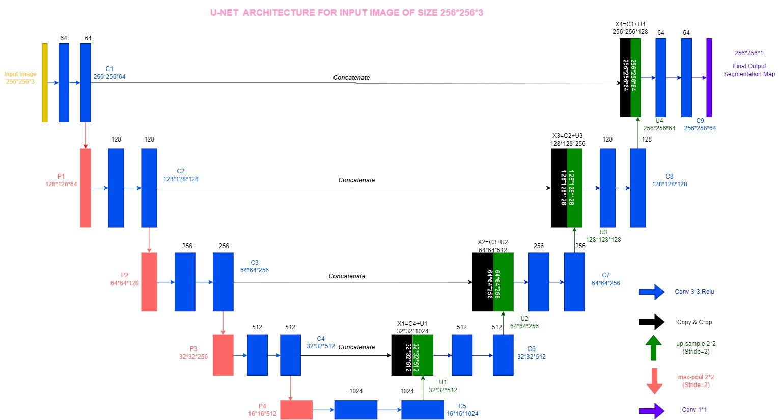
Proposed system architecture
Fig 1: U-NET ARCHITECTURE

Slide 18
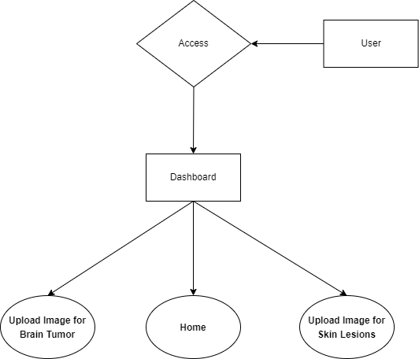
Fig 2: E-R Diagram of User Interface

Slide 19
Proposed Methods
The user interface of the system focuses on addressing two specific medical conditions: brain tumors and skin lesions. Users interact with the system by uploading medical images related to these conditions, and the desired output is a masked image that highlights and isolates the identified areas of interest, facilitating a more detailed analysis.
The underlying model employed for this biomedical image segmentation system is U-Net, a convolutional neural network architecture renowned for its effectiveness in semantic segmentation tasks. U-Net is particularly well-suited for accurately delineating complex structures in medical images, making it an ideal choice for tasks such as identifying brain tumors and skin lesions.

Slide 20
In terms of technology, the system utilizes the Django framework, providing a robust foundation for web application development. The front-end components are built using HTML, CSS, and JavaScript to ensure a user-friendly and responsive interface. The back-end functionalities are supported by an MSSQL database, which efficiently stores and manages the uploaded medical images and corresponding segmentation results. The back-end programming language driving the system is Python, chosen for its versatility and suitability for image-processing tasks in the biomedical domain. This comprehensive technological stack ensures seamless integration of the U-Net model into a user-friendly web application tailored for medical image segmentation.

Slide 21
Comparison of Proposed system with an existing system
Existing System:
In the current scenario of image segmentation, several challenges and drawbacks hinder the effectiveness of existing systems.
One significant problem is the complexity and time-consuming nature of manual image segmentation.
The traditional approach often relies on labour-intensive processes, where experts manually delineate regions of interest in medical or other images
This manual effort is not only resource-intensive but is also prone to human errors and subjectivity, impacting the accuracy and reliability of segmentation results.

Slide 22
Proposed System:
The system offers a higher level of precision and accuracy compared to traditional methods.
It can capture intricate details and complex structures within images, leading to more reliable segmentation results.
One of the significant advantages is the automation of the segmentation process.
U-Net can handle large datasets efficiently, saving time and resources.

Slide 23
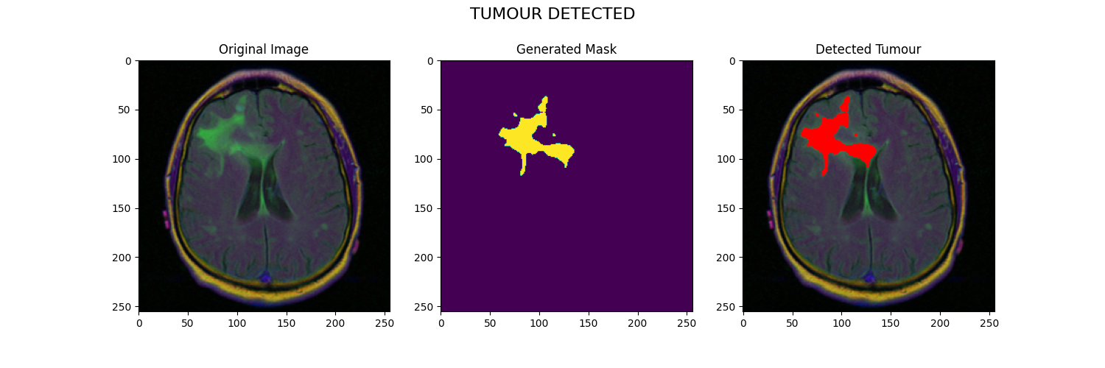
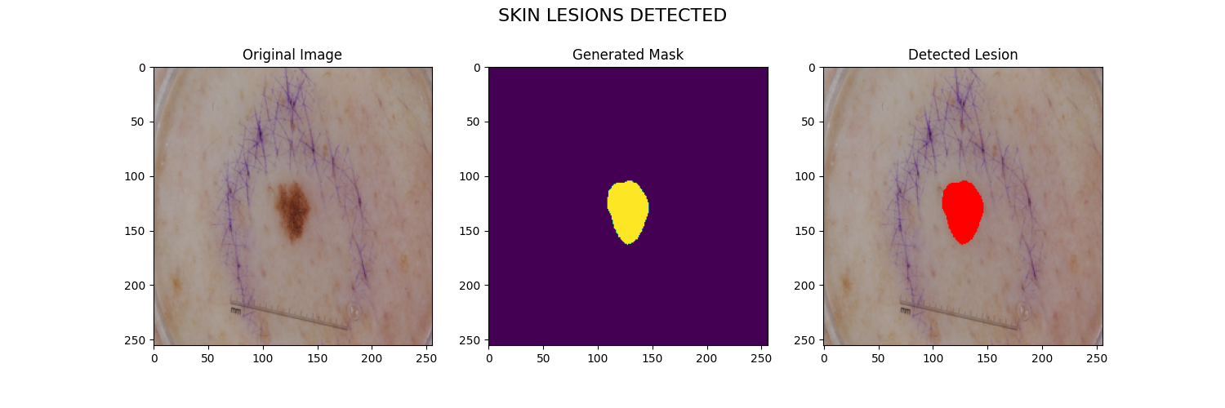
Performance Measure:
The figure 2 illustration depicts the identified location of a brain tumor within the input image and its corresponding representation are the segmented region highlighting the tumor area extracted from the input image.
The figure 3 showcases the identified The position of a skin anomaly within the input image, along with the delineated area extracted
from the input image.
Fig 3:Brain Tumour Disease Fig 4: Skin Lesion Disease

Slide 24
Result Analysis
The outcome of our proposed implementation involves selecting between brain tumors or skin lesions. Afterward, we upload the image or input images. From the input image, we receive results indicating the detected tumor or lesion region, along with a masked image. Additionally, we receive information regarding the presence of tumors or lesions in the input image. If no tumor or lesion is detected, we obtain an empty masked image without any segmented regions of tumors or lesions. In such cases, no detected tumor or lesion regions are displayed in the image.

Slide 25
Conclusion
Our implementation of the U-Net architecture prioritizes lightweight design without compromising segmentation accuracy, thereby minimizing the need for extensive data augmentation. This framework shows potential for integration into medical settings, where trained physicians could utilize it as a supplementary tool for evaluating patients' MRI or skin images. While investigations into brain tumour segmentation using deep learning have made considerable strides, additional research is necessary to further advance the field warranted to enhance the network's performance, particularly in reducing false negatives and false positives in biomedical image analysis.

Slide 26
Future work
Future research endeavours could explore the incorporation of disease-specific information for brain tumours or skin lesions, potentially offering substantial benefits to the medical community.
Integrating U-Net with multi-modal imaging data could enhance its ability to segment structures across different imaging modalities. Combining information from modalities such as MRI, CT, PET, and histopathology images could provide richer contextual information for more accurate segmentation, particularly in medical imaging applications.
Developing interactive segmentation frameworks that combine the strengths of deep learning models like U-Net with user input could empower clinicians and researchers to refine segmentation results in real-time. This could involve incorporating user feedback into the segmentation process through interactive interfaces, enabling more accurate and clinically relevant segmentation outcomes.

Slide 27
References
Ramin Ranjbarzadeh et al, "Brain tumor segmentation built upon DL techniques and an attention mechanism using MRI multi-modalities brain images", Scientific Reports,11 Article number 10930 , May 2021.
Lina Liu Ying Y.Tsui et al,"Skin Segmentation of Lesions Utilizing DL with Auxiliary Task",J Imaging,April 2021.
Hihao ,"Medical Image Segmentation Derived from U-Net", Journal of Physics:Conference Series,vol.2547 , 2023
Mohammed Khouy ,"Medical Image Segmentation Using Automatic Optimized U-Net Architecture Based on Genetic Algorithm",MDPI,Aug 2023.
cafer budak,"Biomedical Image Partitioning Using Modified U-Net",IIETA,March 2023.
Olaf Ronneberger,"U-Net: Convolutional Networks for Biomedical Imaging Segmentation",vol.9351,nov 2015.

Slide 28
Thank You!

